Slide 1
Aerosols and Climate, Past and Present
Results from the Physics Department
NOAA/NSF Greenland site
Thomas A Cahill and the
UC Davis DELTA* Group (1994- present)
Dr. David Barnes (until 2015), typically 1 or 2 grad students, 2 Physics and 2 Engineering UG students, and 1 or 2 non-UCD faculty collaborators
Detection and Evaluation of Long-range Transport of Aerosols,
with major support from the College of Engineering

Slide 2
Take home message:
The Earth balances on an energy knife edge, and 12,000 years ago, it fell off.
(… and it seriously wobbled in 1816…)
Past disasters with aerosol components:
    The “Snowball/Slushball Earths”,
    Permian and Yucatan extinctions
Aerosols and climate, - 450 kyears to – 1,000 years
    The Ice ages and the Younger Dryas mystery
    UCD data on Greenland ice cores
Aerosols and climate, - 1,000 years to + 85 years
    Current climate change
    UCD data on Greenland aerosols

Slide 3
Short wavelength cycle,
Sunlight (6000 K, 0.4 to 0.6 μm), 1353 w/m²
= 100%
100%
(albedo = 0.09)
31%
4%
19%
10%
50%
rain
23%
2/3 oceans, 1/3 land
Variable, average = 46%

Slide 4
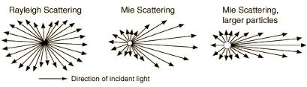
Back scattering of incoming solar radiation
K_{λ} = σ/πr² approaches 5
K_{λ} = σ/πr² approaches 2
Blue sky ~ 1/λ⁴
Reflected light
Clouds
Too few aerosol particles to scatter light effectively:
Light from the sun

Slide 5
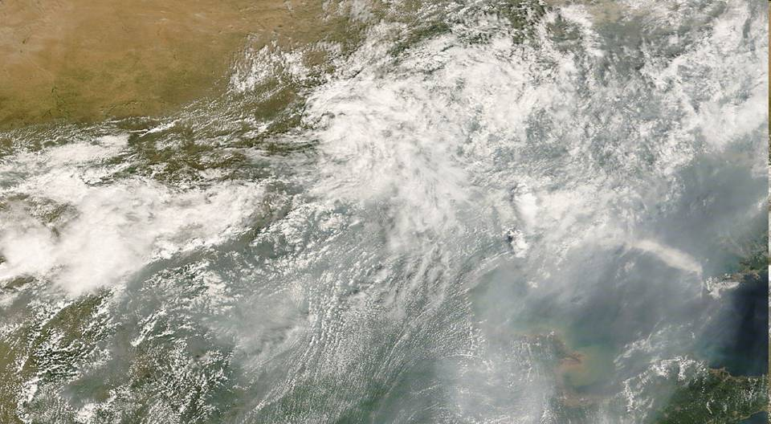
MODIS, 08/08/2008; T avg =29.7 C, RH avg = 72%, rain = 0.0 cm, V_{w} = 8.3 km/hr, Visibility = 3.6 km, PM₁₀ = 156 μg/m³
Beijing

Slide 6
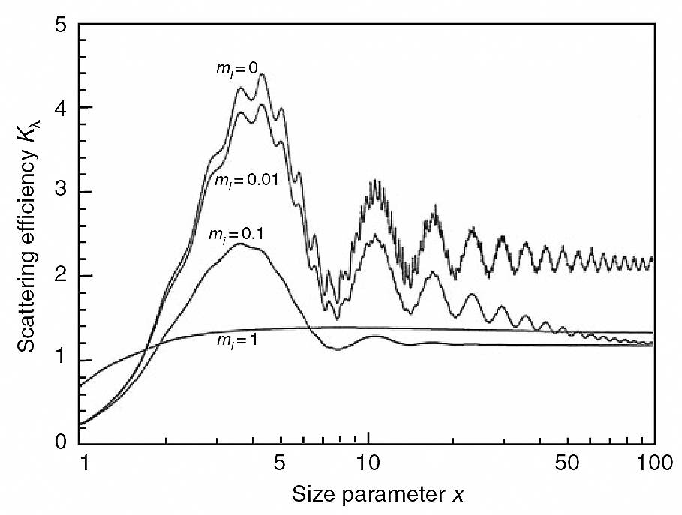
Scattering efficiency K_{λ} = σ/πr² per particle
Size parameter χ = 2πr N_{m}/λ (~ π D/λ)
Pure scattering – water, sulfates, nitrates,..
m_{i} = 0, pure scattering; m_{i} = 1, pure absorption
Optically efficient aerosols
Pure absorbing - soot, …
Too few aerosol particles to scatter light effectively: exception - clouds
Diameter ≅ λ

Slide 7
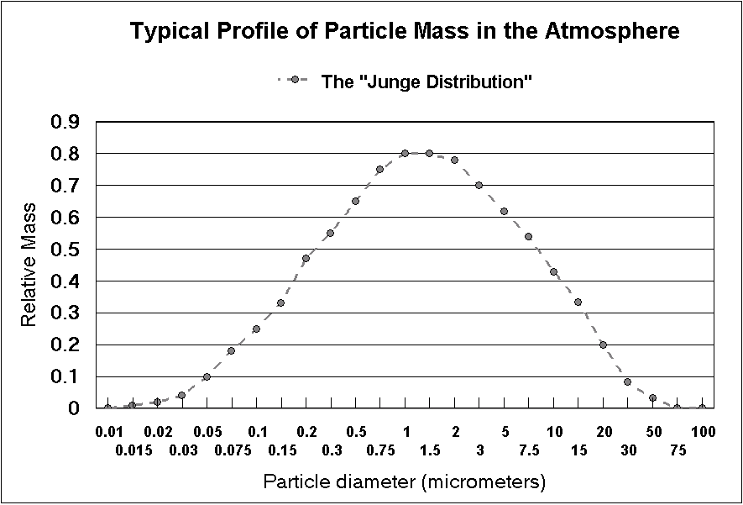
Standard assumption of the size distribution of ambient air aerosols < 1970

Slide 8
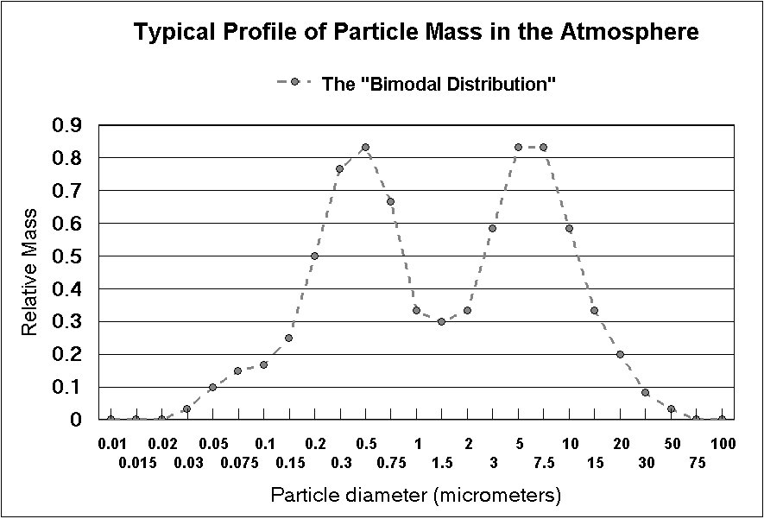
Typical size distribution of ambient air aerosols
> 1970 with optically efficient aerosols shaded
Accumulation mode - long atmospheric lifetimes – nitrates, sulfates, wood smoke…
Mechanical mode – short atmospheric lifetimes- dust, sea salt, pollen, …
Diffusion and condensation
Optically efficient aerosols
Gravitation vs air viscosity

Slide 9
Measuring aerosols? Some options used in the 1970’s by the most successful groups
US EPA/CA ARB 24 hr mass
U. Minnesota several hr mass vs size
U Nevada, DRI many hr chemistry vs size
Lund, Sweden several hr elements vs size (PIXE)
Florida State continuous elements vs time
UC Riverside continuous size and time (drum)
    I used UC Riverside’s rotating drum impactor and added the Swedish technique Proton Induced X-Ray Emission (PIXE) from our cyclotron, and then innovated from that base.
UC Davis continuous size, time, elements
  .

Slide 10
Typical size distribution of ambient air aerosols
> 1970 with optically efficient aerosols shaded
Accumulation mode - long atmospheric lifetimes – nitrates, sulfates, wood smoke…
Mechanical mode – short atmospheric lifetimes- dust, sea salt, pollen, …
Aerosols that dominate global albedo
Optically efficient aerosols
10⁶ particles
1,000 particles
1 particle

Slide 11
Long wavelength cycle
31% = 3 % Rayleigh + 12% Mie (very fine) + ~ 1% Mie (coarse) + 15% clouds
Sunlight (6000 K, 0.4 to 0.6 μm), 1353 w/m²
100%
6%
60%
= 100%
31%
4%
19%
113%
aerosols
gasses
10%
50%
rain
119%
105%
23%
2/3 oceans, 1/3 land
Greenhouse effect ~ + 30 C
Variable, average = 46%
Earth, (300 K, 10 μm, 338 w/m² )

Slide 12
The Earth’s energy balance is critically dependent on the global albedo.
Albedo of ocean water ~ 0.06, or ~ 6% of all light reaching the surface is reflected
Forests and meadows, ~10%
Sand and deserts ~ 28%
Volcanic eruptions, dust storms ~ 40% ± 15%
Clouds ~ 50%
Albedo of ice and snow is ~ 60%

Slide 13
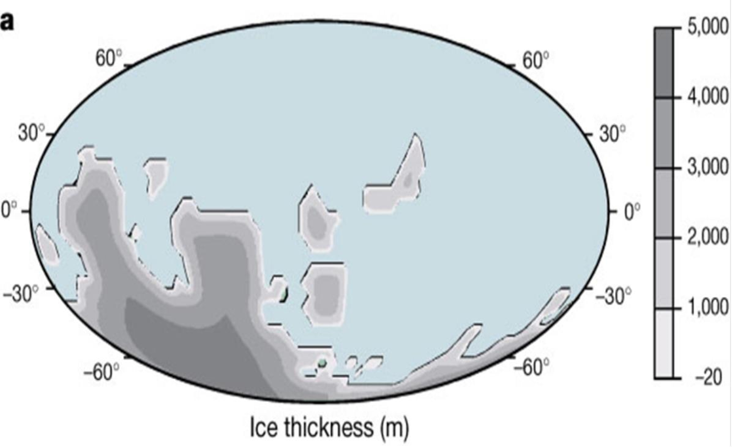

Map of the Earth, ~ 850 to 650 million years ago

Slide 14
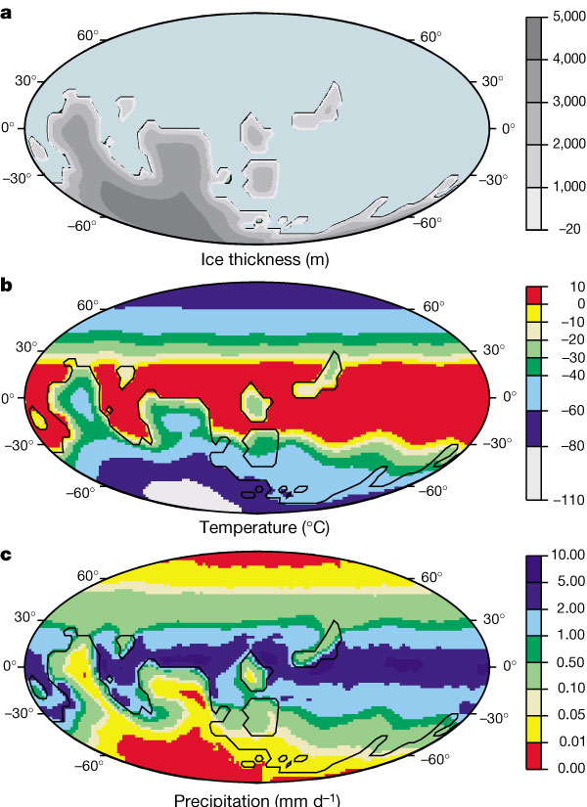
One model of a Slushball Earth:
Requirements:
1. Significant continental land mass near the equator, and
2. A trigger event cools a) asteroid impact b) super volcano c)other
3. Snow at low latitudes – albedo from 0.28 to 0.60; then oceans start to freeze, from 0.06 to 0.60
4. Locks into a Slushball phase
Flood basalt events

Slide 15
One model of a Slushball Earth:
Requirements:
1. Significant continental land mass near the equator, and
2. A trigger event a) asteroid impact b) super volcano c)other
3. What brought us out of it? a) CO₂ rose to 13% (vs current 0.04%) b) oceans thaw c) eventually the land mass split up
Flood basalt events

Slide 16
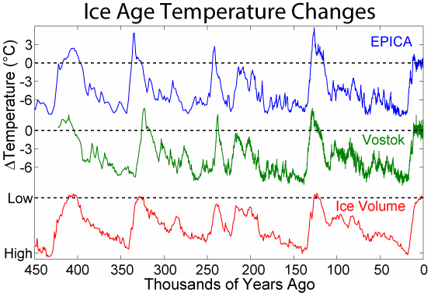

Slide 17
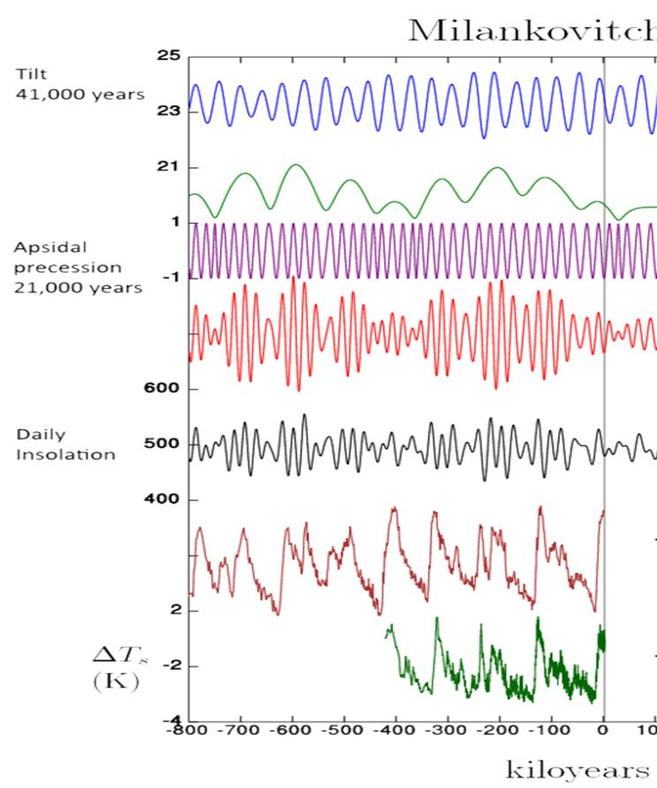
Milankovitch Cycles
Eccentricity 96,000 and 413,000 years
Eccentricity 96,000 and 413,000 years
Good news? If you solve this problem, you will be famous!
Bad news: We are seriously messing with a climate system we don’t fully understand
Axial precession 26,000 years
Axial precession 26,000 years
Temperature from benthic forams (shells) δ¹⁸ O
Benthic forams δ¹⁸O (‰)
Temperature from ice cores
Vostok ice core
kiloyears

Slide 18
?
Greenland cores

Slide 19
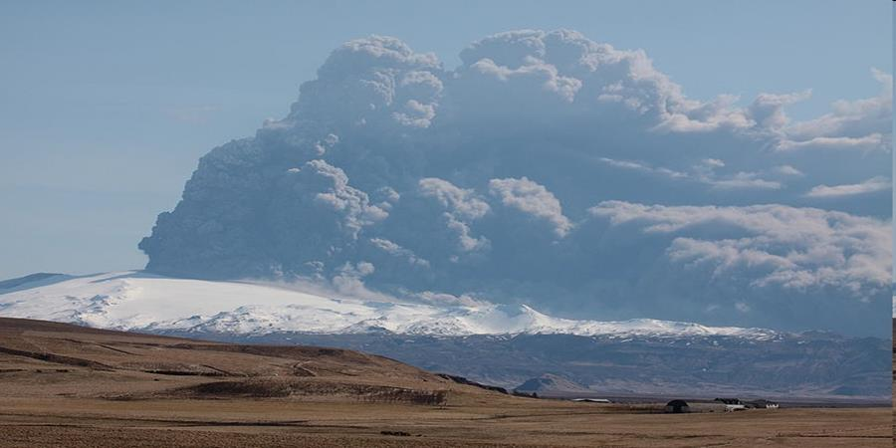
Did a volcano trigger a sudden cooling of the Earth?
Iceland, April 17, 2010, Eyjafyallajokull, Volcanic Explosive Index (VEI) 4
5 | > 25 km | 1 to 10 km³ | Plinian | St. Helens (1980)
6 | > 25 km | 10 to 100 km³ | Plinian – Ultra Plinian | Krakatau (1883) ( ~ 1.2 C)
7 | > 25 km | 100 to 1000 km³ | Ultra Plinian | Pinatubo (1991) (-0.5 C) Tambora (1815) 150 km ³
8 | > 25 km | 1,000 km³ 2,800 km³ 2,400 km³ 5,000 km³ | Ultra Plinian | Taupo (25 ka) Toba (74 ka), Yellowstone, (2.1 ma) La Garita, CO (25 ma)

Slide 20
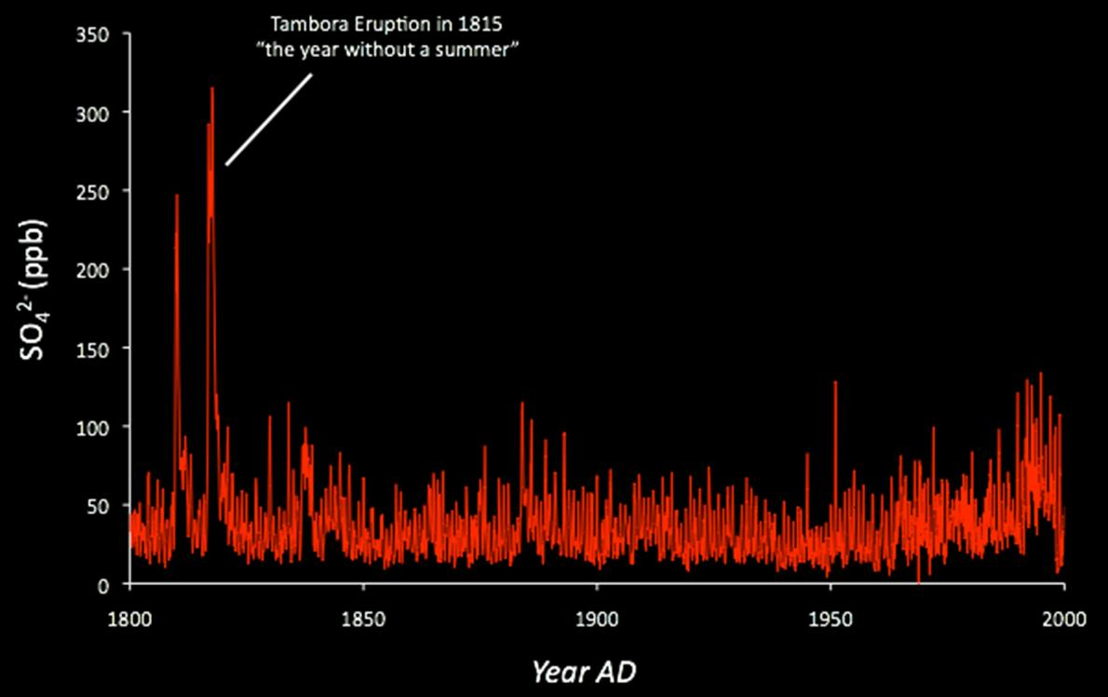
New chemical data from shallow cores in Antarctica
Tambora eruption, 1815. 1816 was
“the year without a summer”
The warm cycle to Ice Age temperature swing is about - 10 to - 12 C
Temperature estimate, - 3 to - 4 C
Pinatubo 1991 global temp – 0.5 C
Krakatoa 1883
global temp -1.2 C

Slide 21
Did a volcano trigger a sudden cooling of the Earth?
Iceland, April 17, 2010, Eyjafyallajokull, Volcanic Explosive Index (VEI) 4
5 | > 25 km | 1 to 10 km³ | Plinian | St. Helens (1980)
6 | > 25 km | 10 to 100 km³ | Plinian – Ultra Plinian | Krakatau (1883) ( ~ 1.2 C)
7 | > 25 km | 100 to 1000 km³ | Ultra Plinian | Pinatubo (1991) (-0.5 C) Tambora (1815)
8 | > 25 km | 1,000 km³ 2,800 km³ 2,400 km³ 5,000 km³ | Ultra Plinian | Taupo (25 ka) Toba (74 ka), Yellowstone, (2.1 ma) La Garita, CO (25 ma)

Slide 22
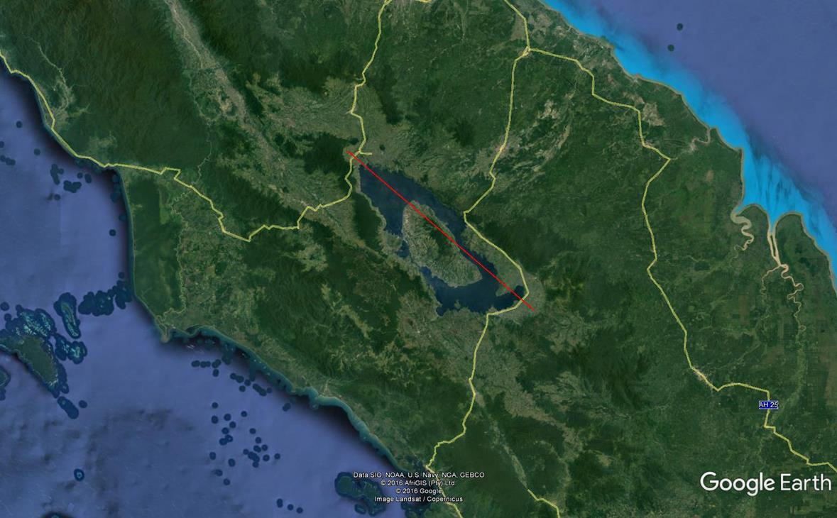
Site of the Toba eruption 74,000 years ago in northern Sumatra
105 km caldera

Slide 23
Toba eruption, “nuclear winter”

Slide 24
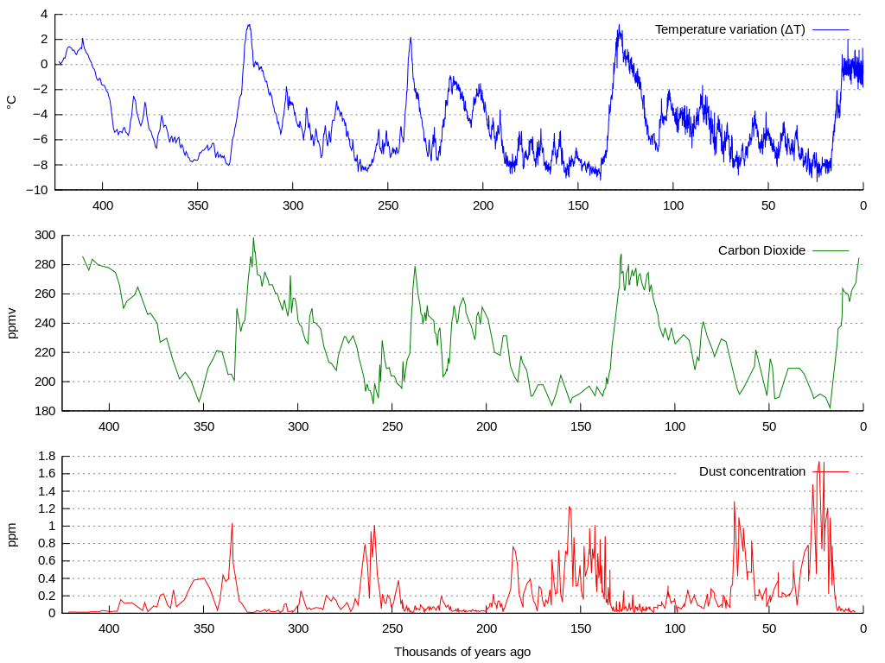
Current level = 400 ppm
Dust concentration in ice cores
Younger Dryas
Toba Taupo

Slide 25
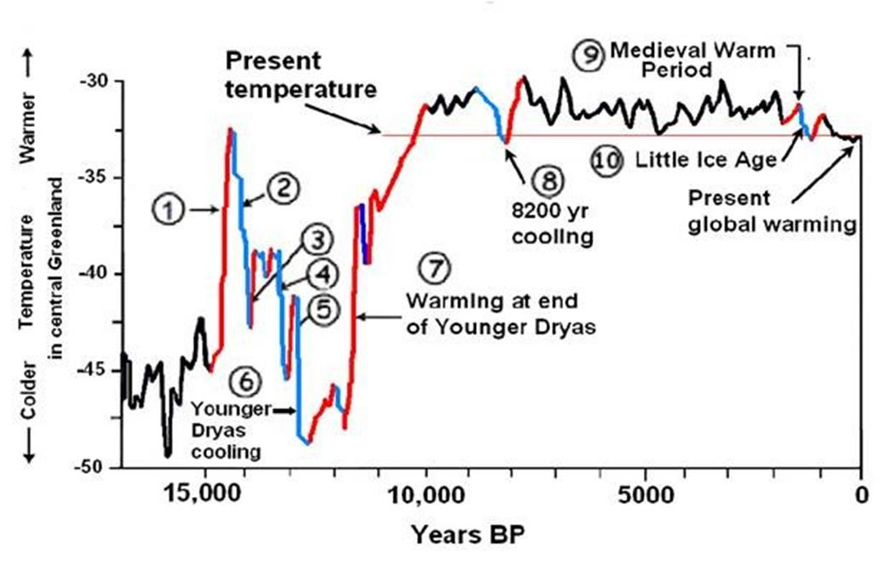
Our work – the mysterious Younger Dryas ice age (Greenland Stadial 1 GS-1)
Problem: these changes happened so rapidly!
Dryas: ± 10 C in~150 years (1,2)
Younger Dryas ± 9 C in ~ 22 years (5,7)
Paris Accords: +1.5 C (2 C?) in 85 years

Slide 26
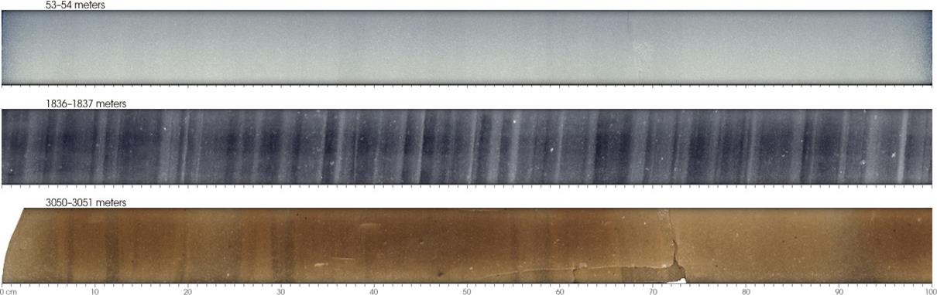

Millimeter wide annual layers in Greenland Ice Cores

Slide 27
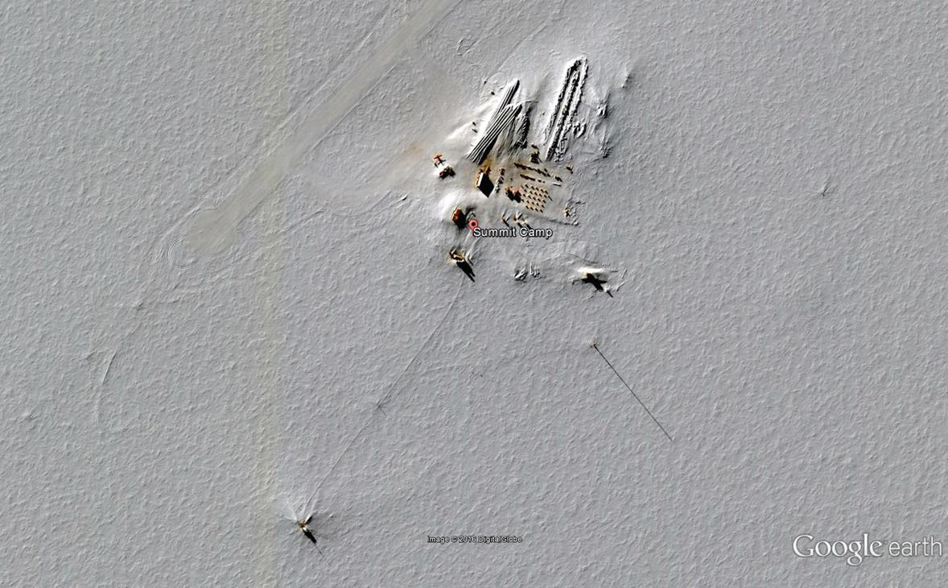
NSF/NOAA Greenland Summit site
38º 28’ 11.4” west, 72º 34’ 25.25” N, elevation 3192 m (10,533 ft)

Slide 28
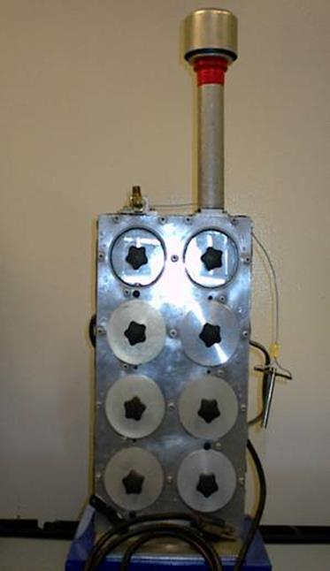
DELTA Group slotted 8 DRUM Impactor
8 size ranges:
  Inlet ( ~ 12) to 5.0 μm
  5.0 to 2.5 μm
  2.5 to 1.15 μm
  1.15 to 0.75 μm
  0.75 to 0.56 μm
  0.56 to 0.34 μm
  0.34 to 0.26 μm
  0.26 to 0.09 μm
10.4 l/min, critical orifice control, ¼ hp pump
6.5 x 168 mm Mylar strips
For 42 day run, 4 mm/day,
time resolution = 1 hr.
Field portable
  10 kg, 43 × 22 × 13 cm
Optically efficient aerosols
43 cm

Slide 29
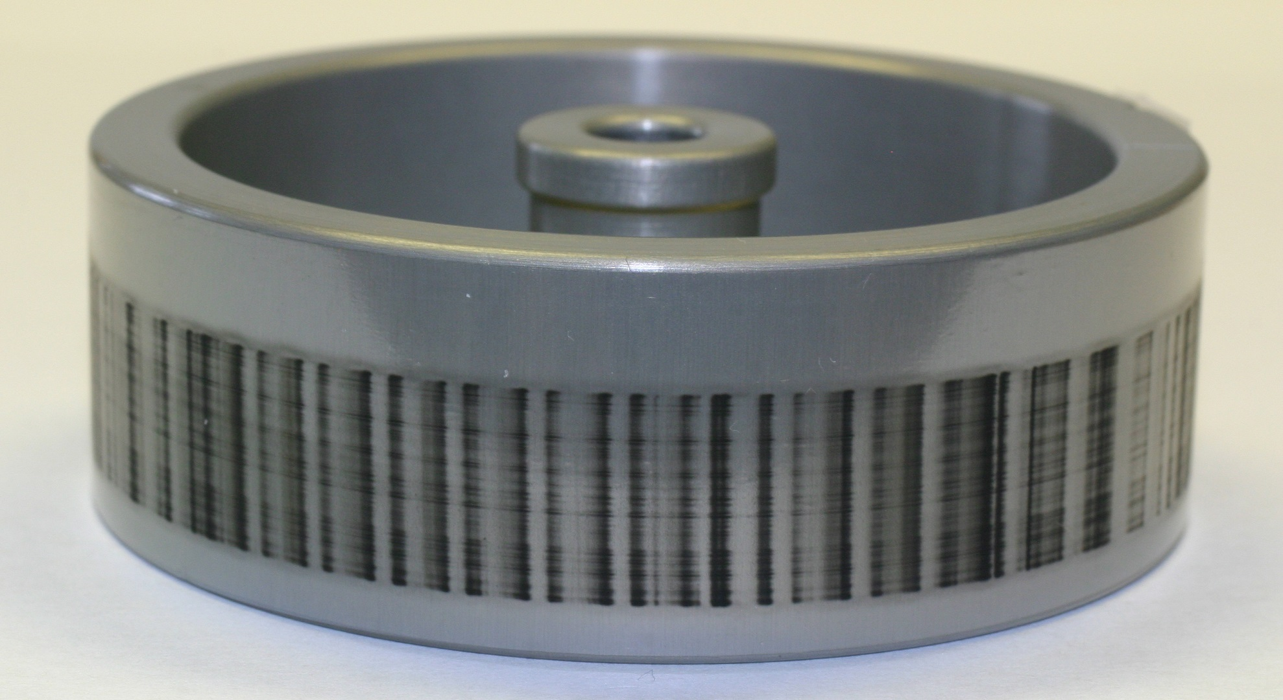
Example: Stage 8 of DRUM , 0.26 > D_{p} > 0.09 µm diameter, showing strong diurnal pattern; the deposit shown covers 3 weeks. This is from South Lake Tahoe

Slide 30
DELTA Group slotted 8 DRUM Impactor
8 size ranges:
  Inlet ( ~ 12) to 5.0 μm
  5.0 to 2.5 μm
  2.5 to 1.15 μm
  1.15 to 0.75 μm
  0.75 to 0.56 μm
  0.56 to 0.34 μm
  0.34 to 0.26 μm
  0.26 to 0.09 μm
10.4 l/min, critical orifice control, ¼ hp pump
6.5 x 168 mm Mylar strips
For 24 week run, 1 mm/day,
time resolution = 12 hr.
Field portable
  10 kg, 43 × 22 × 13 cm
43 cm

Slide 31
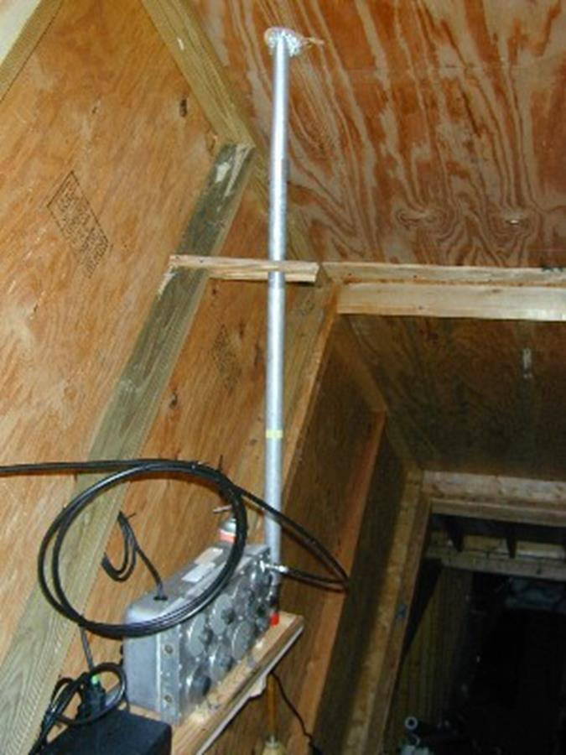
UC Davis DRUM sampler in tunnel under circa 6 feet of snow

Slide 32
Greenland DRUM strips against white background
Date scale is approximate; fine soot from Summit diesels will set final dates
10 to 5.0
5.0 to 2.5
2.5 to1.15
1.15 to 0.75
0.75 to 0.56
0.56 to 0.34
0.34 to 0.26
0.26 to 0.09
July 16 2015 8/1 9/1 10/1 11/1 12/1 1/1 2/1 3/1 4/1 5/1 June 1

Slide 33
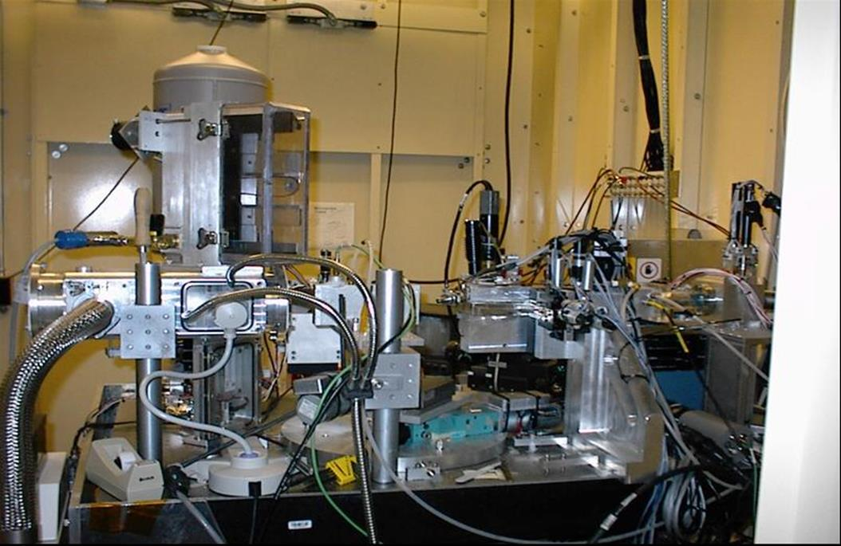
The UC Davis/Lawrence Berkeley NL Advanced Light Source aerosol S-XRF microprobe –
250,000 analyses, mostly for climate studies, continuous DRUM 8 size modes, each with 32 elements, to pg/m³, 1999 – 2007
DRUM strip
X-ray beam

Slide 34
A “White Beam”? You have got to be kidding!
In x-ray fluorescence analysis, scientist have avoided using broad spectrum “white beams” for years, because
  a. They give a high continuous background, reducing sensitivity,
  b. They make calculations of quantitative yields difficult, and
  c. Self absorption corrections in thick samples are hard
For this reason, modern XRF uses Bragg crystals to get monochromatic x-ray beams whenever possible.
  a. But there is a price to pay – costs 99.9% of flux
But synchrotron x-rays are plane polarized
  a. We moved the detector to 90º - removes 99% background
  b. We wrote programs to make calculations easy and accurate
  c. We have thin samples - no self absorption problems
Net result: world class accuracy and sensitivity for ~ 42 elements in 30 sec

Slide 35
Synchrotron-X-Ray Fluorescence (S-XRF) spectrum, 30 sec, and AXIL analysis of a remote area aerosol sample. The polarized S-XRF beam suppresses the background by a factor of about 100 versus standard XRF.
10,000 cts/channel
Background without use of the plane polarized x-rays
Co⁵⁷ standard for dead time
1 ng/m³
1 ct/channel

Slide 36
Continuous sampling – inlet at surface, but
DRUM in tunnel under 3 m of snow
Optically efficient aerosols
December January February March April

Slide 37
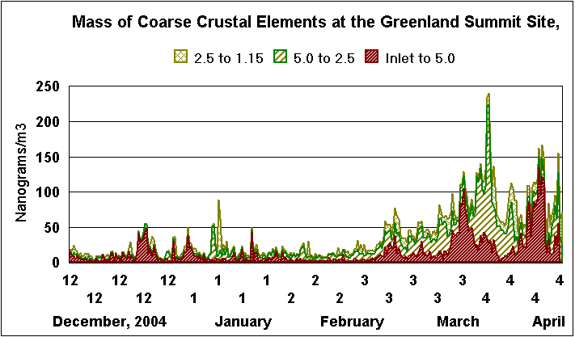

Slide 38
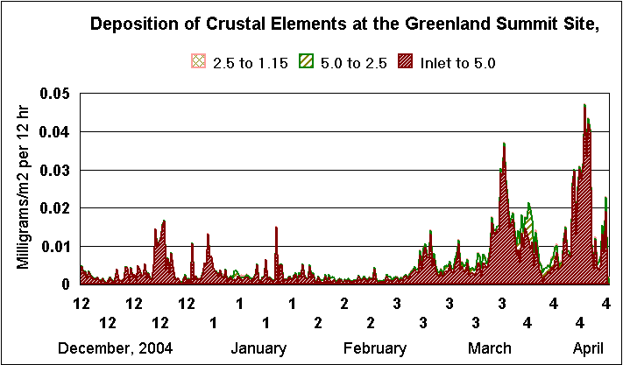

Slide 40
Some Results
The deposition of soils into the Greenland ice cores represents only the small very coarse fraction of the aerosols above the ice sheet
The aerosols that do not deposit are the ones that are most optically active
These aerosols represent a significant increase in the Earth albedo and thus represent a cooling influence
Thus there was much more cooling by dust during the Younger Dryas ice age than previously thought
We propose to study these impacts by direct S-XRF analysis of freeze dried ice cores – resolution? 1 month

Slide 41
Current threats: - 1,000 years to + 85 years - UCD data on Greenland aerosols
We now have 13 years of data on aerosol at the Greenland Summit site classified by
  8 size modes
  12 hr time increments
  Up to 42 S-XRF elements in each size mode
  Optical absorption
Natural aerosols such as dust, forest fire smoke volcanoes, etc relevant to ice cores
Anthropogenic aerosols from power plants, transport, industry and human initiated fires

Slide 42
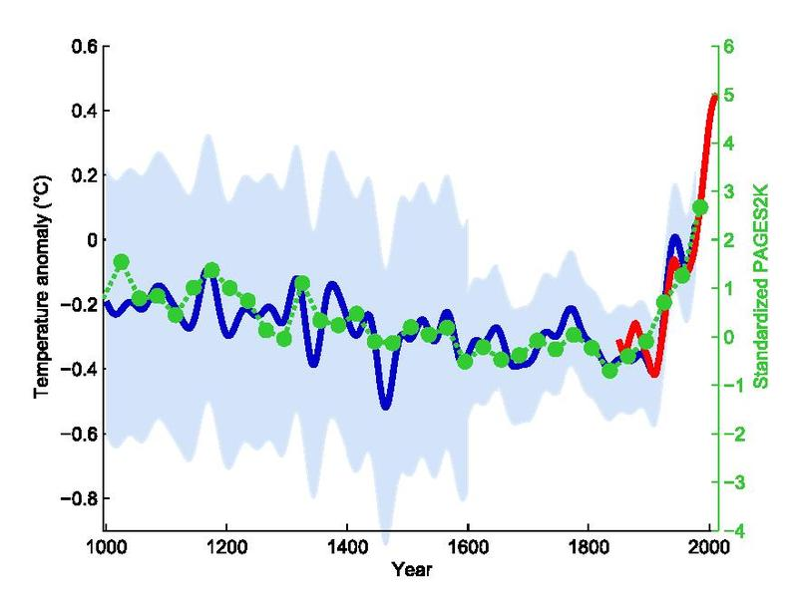
The original northern hemisphere hockey stick graph of Mann, Bradley & Hughes 1999, smoothed curve shown in blue with its uncertainty range in light blue, overlaid with green dots showing the 30-year global average of the PAGES 2k Consortium 2013 reconstruction. The red curve shows measured global mean temperature, according to HadCRUT4 data from 1850 to 2013.

Slide 43
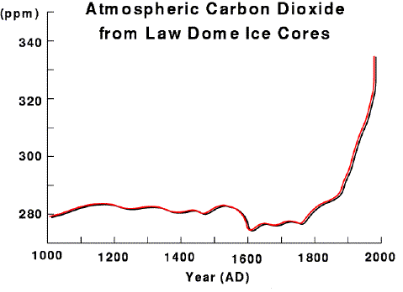
Carbon dioxide for the past 1,000 years
400 ppm

Slide 44
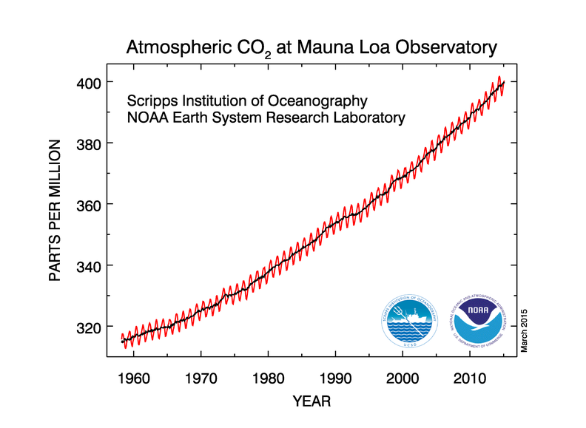

Slide 45
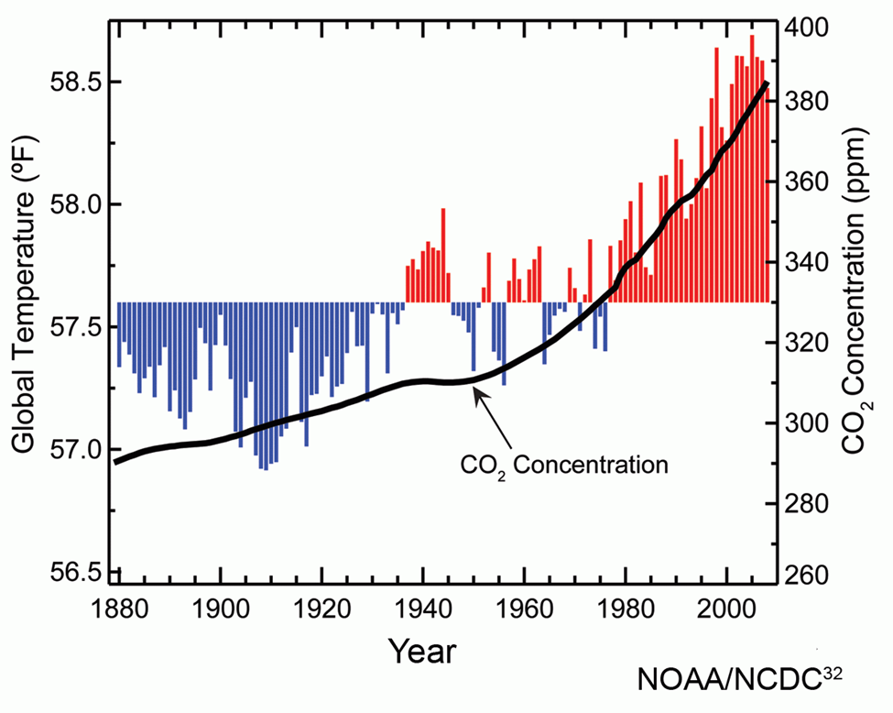
Recent understanding: the oceans have a major impact on global temperature – i.e., El Nino warms, La Nina cools the world

Slide 46
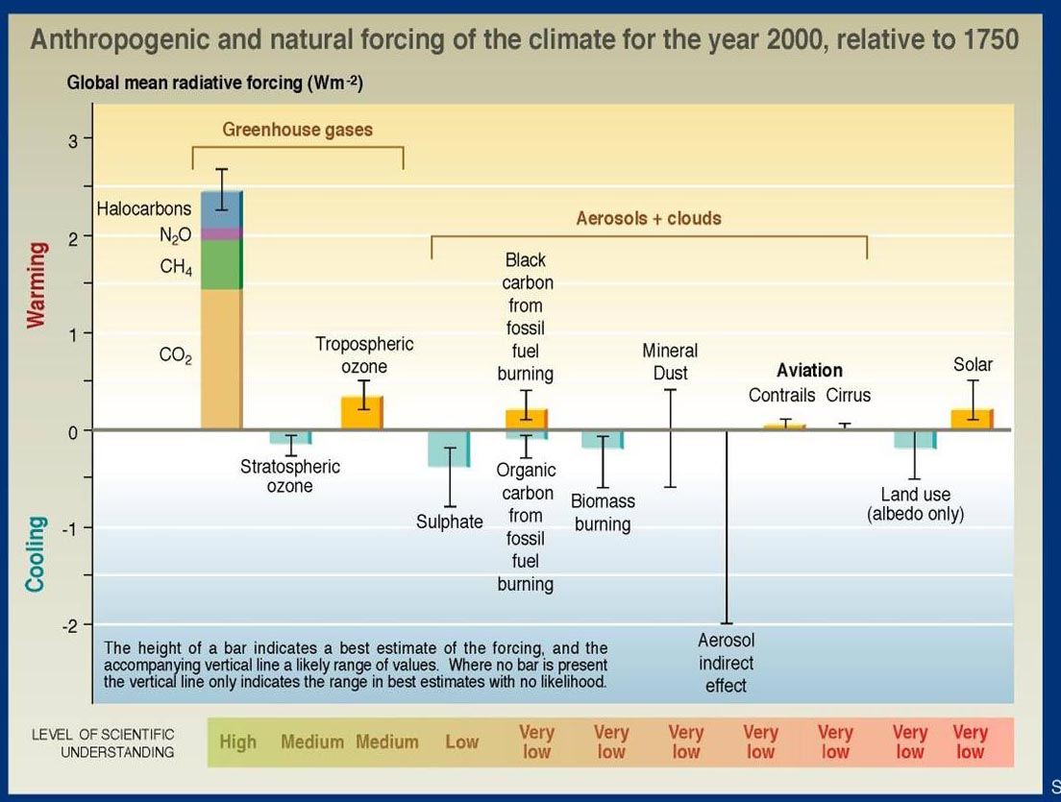
Short wavelength cycle
Long wavelength cycle

Slide 47
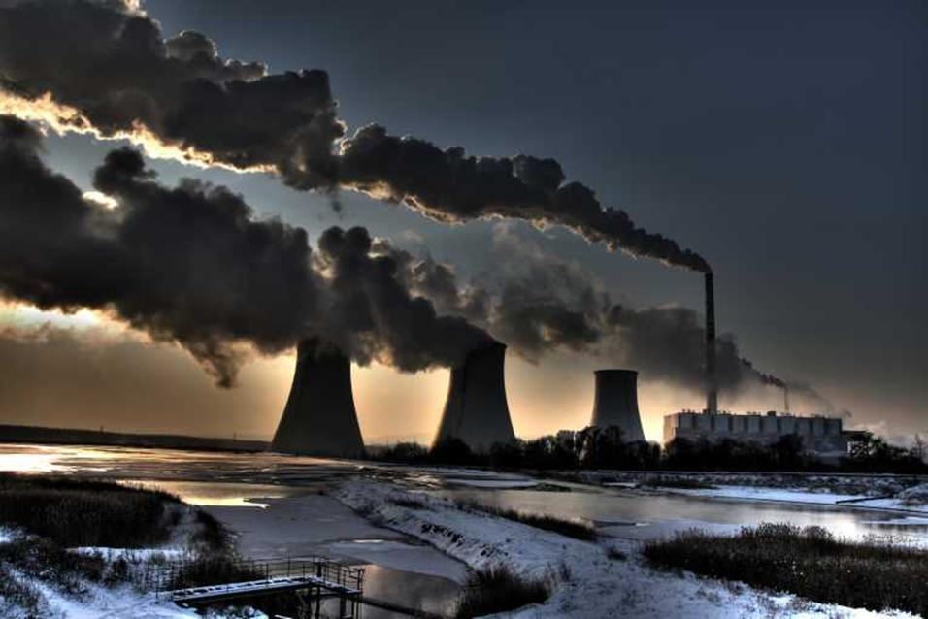
Older Soviet designed power plants burn coal at low temperatures – result, soot. The soot coats dust aerosols and changes them from cooling to heating the world

Slide 48
Continuous sampling – inlet at surface, but
DRUM in tunnel under 2 m of snow
December January February March April

Slide 49
Continuous sampling – inlet at surface, but
DRUM in tunnel under 3 m of snow
USA
China
December January February March April

Slide 50
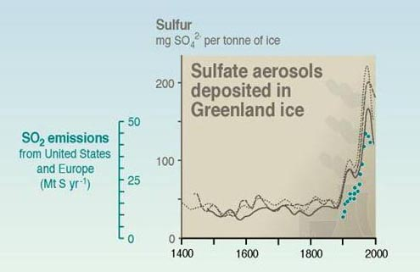
Sulfates in Greenland ice cores; US and Europe only? Note poor match > 1980
China

Slide 51
China
Sahara

Slide 52
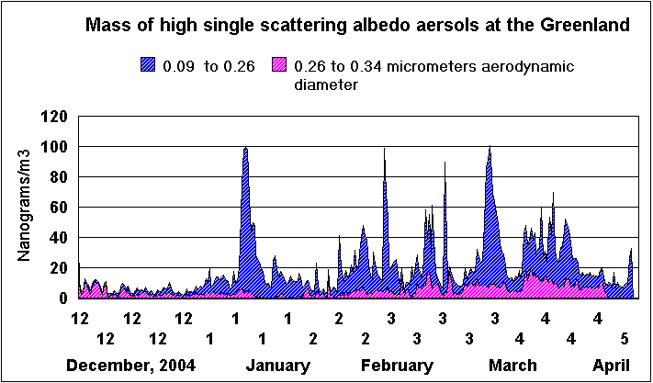

Slide 53
Greenland Summary
The combination of aerosols collected by size, time, and composition, pioneered by our department, when combined with global transport models, allow source identification over much of the Northern Hemisphere
US and European aerosols, dominated by sulfates, tend to cool the Earth
Chinese, Indian, and Indonesian aerosols, rich in soot, tend to heat the Earth
Chinese aerosols arrive at Greenland across the North Pole, doubling the impact of the US and Europe on Greenland
The same process could have operated during the Younger Dryas event

Slide 54
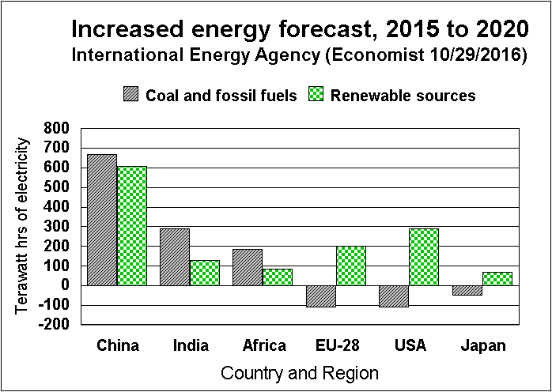
Good news! Carbon emissions have been almost flat for the past 3 years
Bad news! 2014, 2015, and 2016, each was the hottest year ever.
Bad news! Emissions are still far greater than the Earth can sequester, so CO₂ levels continue to rise.

Slide 55
And the future…..
The hard work of global climate research desperately needs the techniques of modern experimental physics
The hard work of global climate research needs new young scientists who both
  Know the needs of the GCM research
  Know the techniques of physics
Each year in Boulder NOAA hosts a major meeting for Climate Monitoring and Diagnostic Laboratories (CMDL) GCM scientists.
  Heads and key staff of all 5 NOAA CMDL sites, include Antarctica
  NOAA, NCAR, NASA, and DOD GCM modelling teams
  WMO climate and modelling groups from all over the world
  Scientists from CMDL associated university programs
The room holds ~ 120 people

Slide 56
And the future…..
The hard work of global climate research desperately needs the techniques of modern experimental physics
The hard work of global climate research needs new young scientists who both
  Know the needs of the GCM research
  Know the techniques of physics
What next?
  NSF Greenland upgraded (CNL, SSRL) and continued to 2021.
  NSF high time resolution (monthly?) SXRF analyses of Greenland ice cores for the Younger Dryas event (with UNR Desert Research)
  NSF (1/31/2017) proposal to statistically mix DRUM aerosols, climate gasses, and HYSPLIT trajectories at Mauna Loa Observatory establish the input of Chinese CO₂ emissions on the annual CO₂ cycle.

Slide 57
  References:
  Best summary of DELTA Group programs; http://delta.ucdavis.edu
  Best article on Greenland: VanCuren, Richard, Thomas Cahill, John Burkhart, David Barnes, Yongjing Zhao, Kevin Perry, Steven Cliff, and Joe McConnell, Aerosols and their sources at Summit Greenland – First results of continuous size- and time-resolved sampling. Atmospheric Environment, 52:82-97 (2012) doi:10.1016/j.atmosenv.2011.10.047
Best article on DRUM technology: Raabe, Otto G., David A. Braaten, Richard L. Axelbaum, Stephen V. Teague, and Thomas A. Cahill. Calibration Studies of the DRUM Impactor. Journal of Aerosol Science. 19.2:183‑195 (1988).
Best article on our SSRL Beam Line: S.R. Barberie, T.A. Cahill, C.F. Cahill, T.M. Cahill, C.R. Iceman, D.E. Barnes. UC Davis XIPline ("zipline") end-station at the Stanford Synchrotron Radiation Lightsource: Development and experimental results. Nucl. Instrum. Meth. Phys. Res. A: Accelerators, Spectrometers, Detectors and Associated Equipment 729:930-933 (2013) doi:10.1016/j.nima.2013.08.043
Best example of our S-XRF at SSRL: Jenniskens, P, Fries, M. D. Qing-Zhu, Y. ….Cahill, T.A., Barnes, D. E., …Verosub, K. …(55 more)…Radar-enabled recovery of the Sutter’s Mill Meteorite, a carbonaceous chondrite regolith breccia. Science, 338:1583-1587 (2012) doi: 10.1126/science.1227163

Slide 59
Map of the Earth, ~ 850 to 650 million years ago

Slide 60
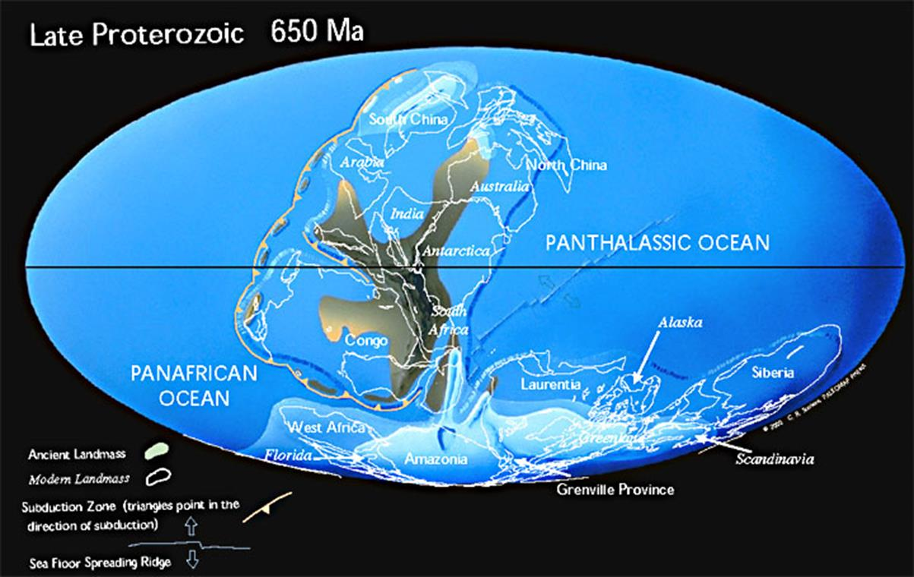
What went wrong? Supercontinent of Rodinia, 1100 my to 650 my, had lots of land mass at the Equator ( ~ same fraction as today!).

Slide 61
At ~ 850 myears ago, an event triggered a sudden cooling of the Earth
Iceland, April 17, 2010, Eyjafyallajokull Volcano, Volcanic Explosive Index
(VEI) 4
4 | 10 to 25 km | 100 millions m³ | Vulcanian - Plinian | Eyjafyallajokull (2010)
5 | > 25 km | 1 to 10 km³ | Plinian | St. Helens (1980)
6 | > 25 km | 10 to 100 km³ | Plinian – Ultra Plinian | Krakatau (1883) ~ -1.2 C, 3 yrs
7 | > 25 km | 100 to 1000 km³ | Ultra Plinian | Pinatubo (1991), -0.5 C Tambora (1815)
8 | > 25 km | 2,800 km³ 2,400 km³ 5,000 km³ | Ultra Plinian | Toba (74 ka), Yellowstone, (2.1 ma) La Garita, CO (25 ma)

Slide 62
One model of a Slushball Earth:
Requirements:
1. Significant continental land mass near the equator, and
2. A trigger event cools a) asteroid impact b) super volcano c)other
3. Snow at low latitudes – albedo from 0.28 to 0.60; then oceans start to freeze, from 0.06 to 0.60
Flood basalt events

Slide 63
One model of a Slushball Earth:
Requirements:
1. Significant continental land mass near the equator, and
2. A trigger event a) asteroid impact b) super volcano c)other
3. What brought us out of it? a) CO₂ rose to 13% (vs current 0.04%) b) oceans thaw c) eventually the land mass split up
Flood basalt events

Slide 64
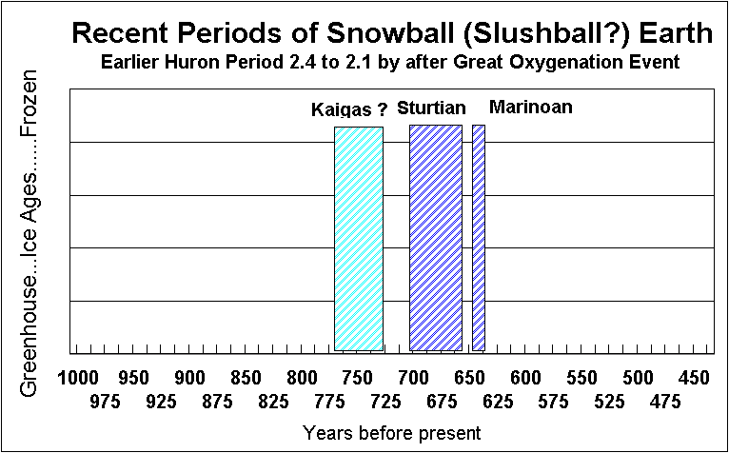
“The Boring Billion”
Volcanic CO² ~ 13%
Gaskiers and Baykonur glaciations
Andean glaciation
Single cell, eukaryotes, and colony biota
?
Ediacaran biota
?
?
?
?
Cambrian Explosion)
(X 10⁶)
Land vegetation

